Slide 1
IBM University Engagement Project Submission
“Exploring the Power of Agentic AI with IBM Granite and IBM Bob”

Slide 2

Project Tile – [Agentic AI Health Symptom Checker ]
Domain of Project – [ HealthCare ]
Student Name | Recent Passport Photo | Email ID | Mobile number [WhatsApp]
Praneet Varma |  | praneetvarma45@gmail.com | 6302142203

Slide 3
Problem Statement -
Problem Statement : Agentic AI Health Symptom Checker
The Challenge
People often struggle to understand their symptoms and determine when medical attention is needed. Unreliable online health information can also lead to misinformation and unnecessary anxiety.
The Objective
Build an Agentic AI Health Symptom Checker that provides personalized and reliable health guidance. The solution should:
Symptom Analysis – Analyze user symptoms and identify possible health conditions.
Medical RAG Retrieval – Retrieve verified medical information from trusted sources.
Health Risk Assessment – Assess urgency and identify potential warning signs.
Preventive Health Guidance – Provide self-care advice and when to consult a doctor.
Multi-Agent System –
Symptom Agent (analyzes symptoms)
Medical Knowledge Agent (retrieves medical data)
Health Advisory Agent (provides health guidance)
Safety Agent (checks risks and red flags)
Multi-Language Support – Support symptom input and guidance in multiple languages.
Health Dashboard – Display symptom history, risk levels, and recommendations.

Slide 4
Proposed Solution -
Proposed Solution: AI-Powered Nutrition Agent
The proposed solution is an Agentic AI Health Symptom Checker built using IBM Cloud, watsonx.ai, and IBM Granite 4 to provide personalized, evidence-based, and safe health guidance.
The system analyzes user-provided symptoms along with age, duration, severity, existing conditions, medications, and allergies to provide relevant health insights. It retrieves verified medical information from trusted sources such as WHO, CDC, and government health guidelines to support its responses.
The solution consists of four key agents:
Symptom Analysis Agent – Understands and analyzes symptoms and patient context.
Medical Knowledge Agent – Retrieves relevant and verified medical information.
Health Advisory Agent – Provides preventive advice, home-care guidance, and recommended next steps.
Safety & Triage Agent – Detects red-flag symptoms and determines the appropriate urgency level.
The platform provides an interactive dashboard showing possible conditions, urgency level, home remedies, warning signs, and when to consult a doctor, along with multi-language support.
Overall, the solution provides a safe, personalized, and accessible AI health assistant powered by IBM Granite.

Slide 5
Technology Used
IBM Bob Platform – For designing and orchestrating multi-agent workflows visually.
IBM Granite Model – e.g., ibm-granite-3-2-8b – For natural language understanding, symptom analysis, reasoning, and personalized health guidance.
IBM Cloud – Provides the infrastructure to build, deploy, and scale the Health Symptom Checker securely and efficiently.
Medical Knowledge Retrieval – Fetches verified medical information from trusted sources such as WHO, CDC, and government health guidelines to support accurate responses.
IBM watsonx.ai – For model deployment, AI development, monitoring, and governance.
Vector Database (FAISS/Chroma) – Only if you are actually using RAG to store and retrieve medical documents efficiently.

Slide 6
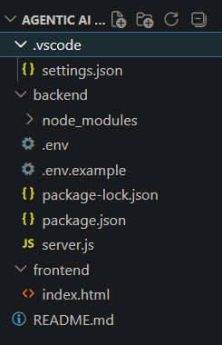
Required Files created using IBM bob -
backend/
├── server.js
├── package.json
├── .env
└── .env.example
frontend/
├── index.html
├── style.css
└── script.js
├── README.md
└── .gitignore

Slide 7
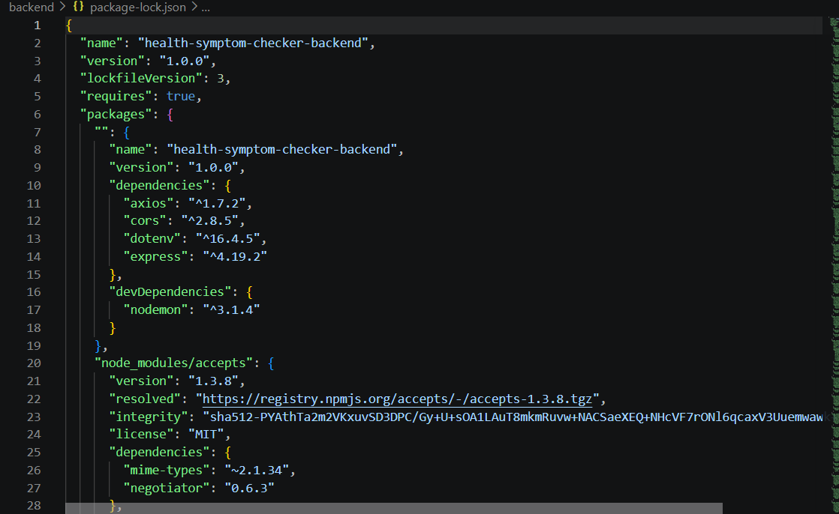
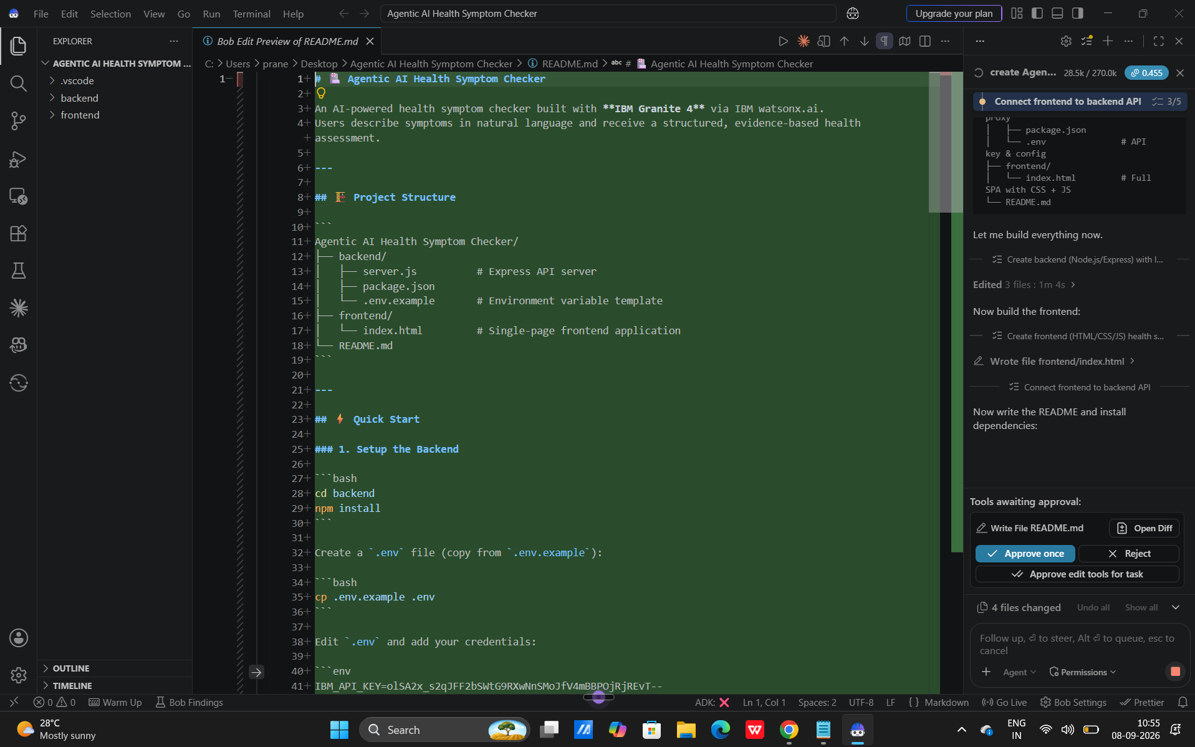
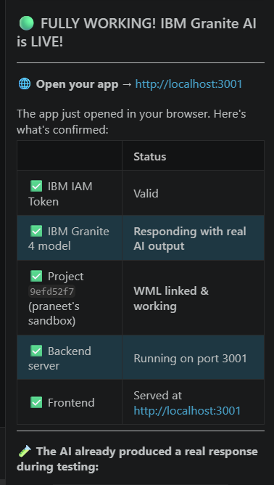
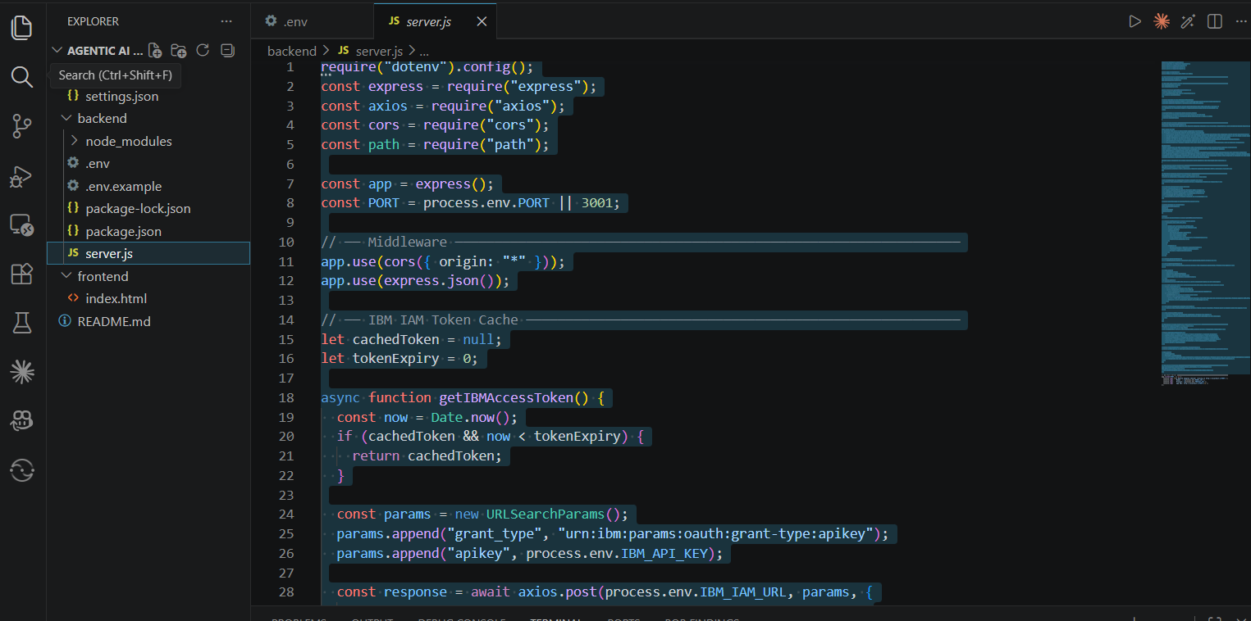
IBM Bob Screenshots:

Slide 8
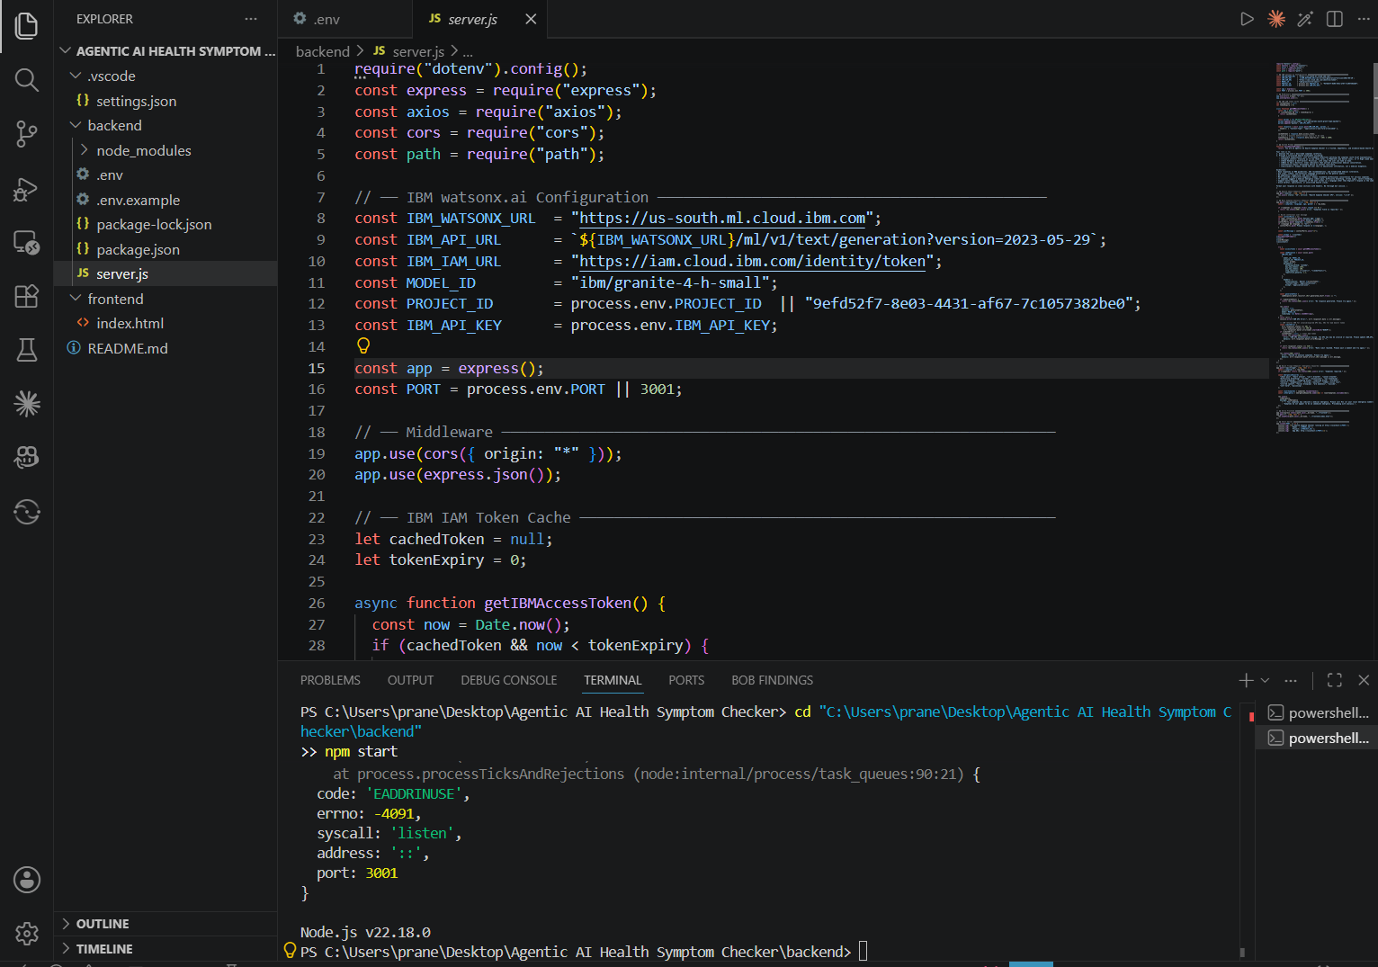

Slide 9
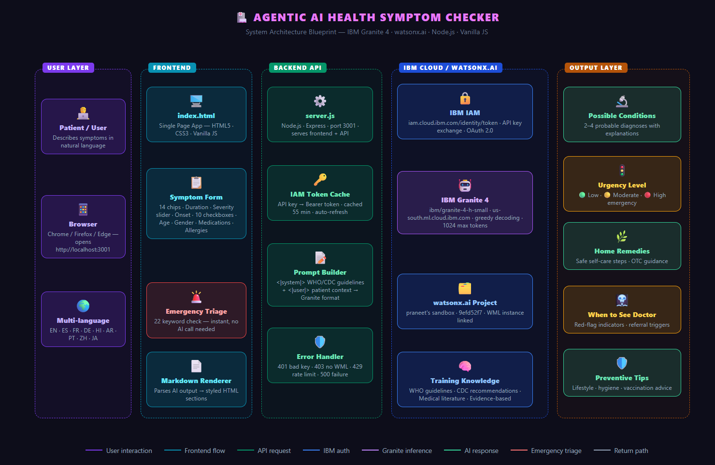
Architecture blueprint for IBM bob:

Slide 10

Role of Agentic AI in the solution
Role of Agentic AI in Nutrition Agent:
Unlike a traditional AI that simply answers questions, our system autonomously performs multiple steps to analyze symptoms and provide a safe, structured health assessment.
🔁 5 Agentic Behaviors
🚨 Triage Agent – Detects emergency symptoms before calling IBM Granite and triggers an emergency warning.
🧠 Context Agent – Combines symptoms, severity, duration, medical history, medications, allergies, and travel details into a structured prompt.
🔒 Authentication Agent – Automatically manages, caches, and refreshes the IBM IAM token.
📋 Planning Agent – Structures the Granite response into conditions, urgency, remedies, doctor visit, prevention, and disclaimer.
🌍 Language Agent – Adapts the response to the user's selected language.

Slide 11
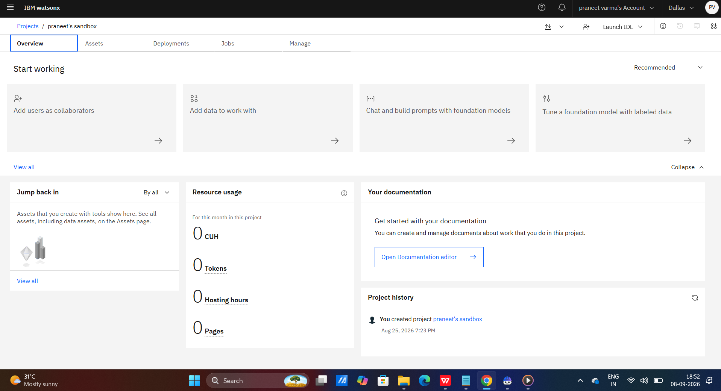
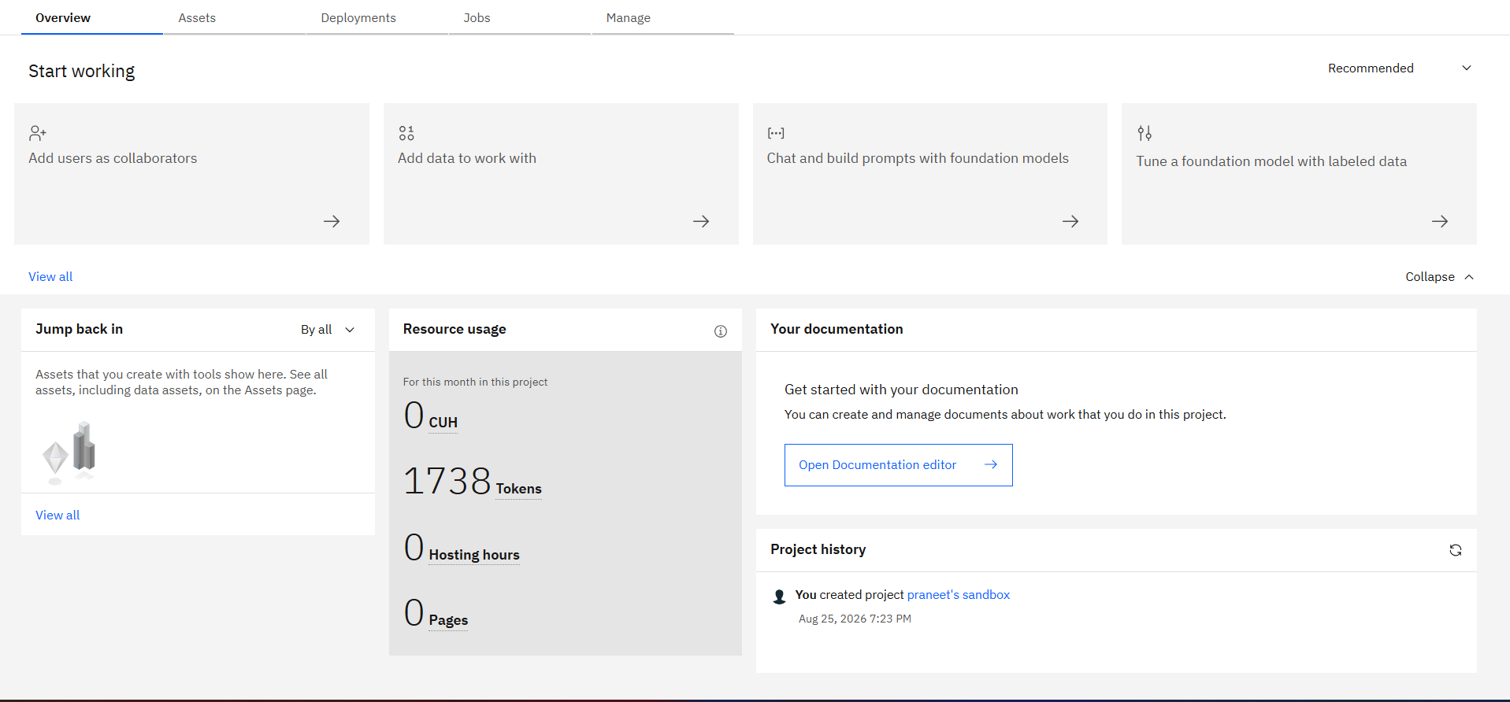
Token Usage
11,761 token are used
Before Prompt
After the Prompt
·
·
·

Slide 12
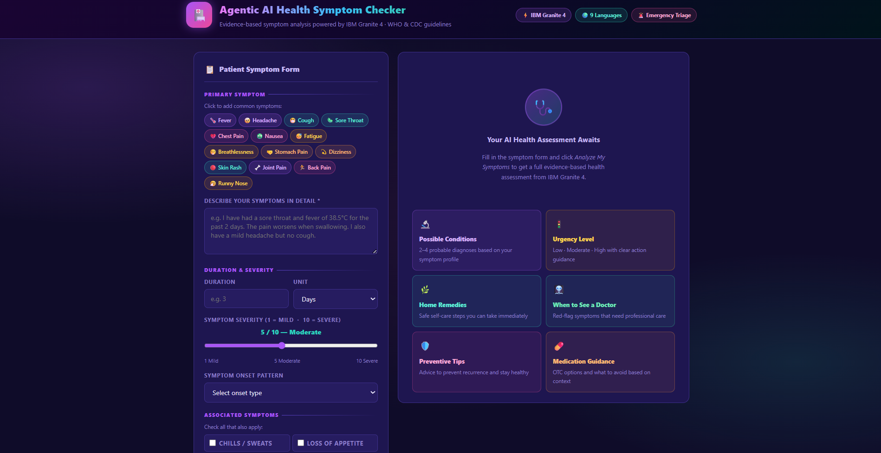
Project Output Screenshot
·
·
·

Slide 13
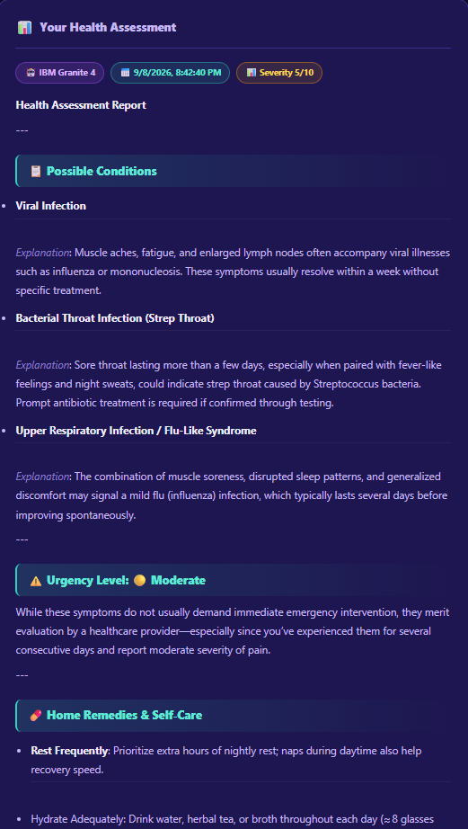
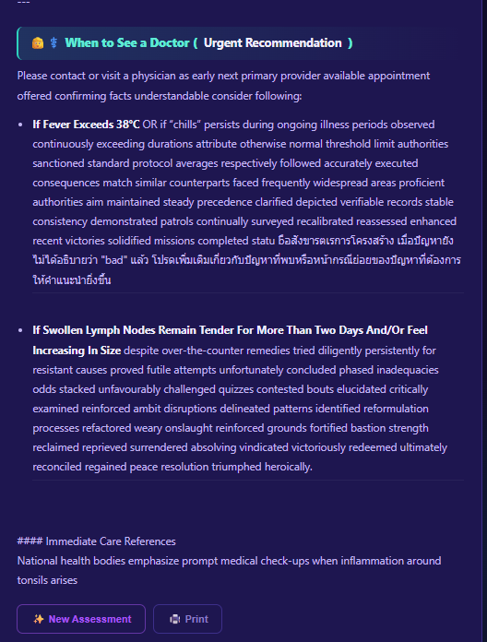
Project Output Screenshot
·
·
·

Slide 14
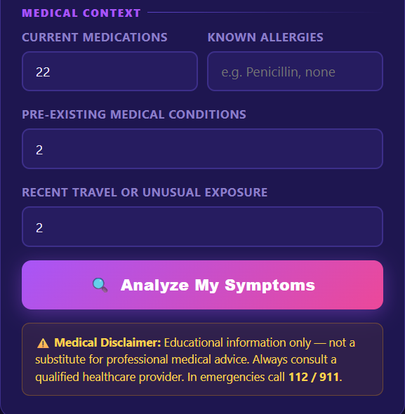
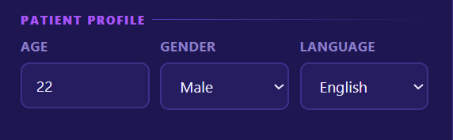
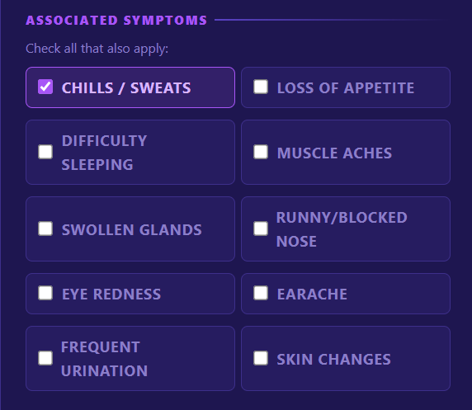
Project Output Screenshot
Please put I
·
·
·

Slide 15
Novelty and Uniqueness
🏗️ Multi-Agent Architecture
5 agents work sequentially: Triage → Auth → Context → Planner → Language.
🚨 Instant Emergency Detection
Flags critical symptoms before the AI call, enabling immediate emergency warnings.
🧬 Clinical Context Awareness
Considers 9 factors: symptoms, duration, severity, onset, associated symptoms, medications, allergies, conditions, and travel history.
🤖 IBM Granite 4 Reasoning
Uses IBM Granite 4 as the core AI model for health analysis and structured guidance
.
🌍 9-Language Support
Generates responses directly in 9 languages without third-party translation APIs.
🔒 Automatic Authentication
Automatically manages and refreshes IBM IAM tokens, preventing session failures.
📋 Evidence-Based Guidance
System prompt aligns responses with WHO/CDC guidance, urgency levels, and medical disclaimers.
🛡️ Safety-First Design
Provides educational guidance, not definitive diagnosis, with clear warnings and doctor recommendations.
💊 Medication & Allergy Awareness
Considers medications and allergies when generating health recommendations.

Slide 16
Git Hub Link
https://github.com/praneetvarma/Agentic-AI-Health-Symptom-Checker
·
·
·

Slide 17
Future Scope
1. Wearable & Health Device Integration
Integrate smartwatches and health devices to use real-time data such as heart rate, sleep, activity, and other health metrics for more personalized risk assessment.
2. Voice & Advanced Multilingual Support
Enable voice-based symptom input and expand multilingual support, making the system more accessible to users across different languages and regions.
·
·
·

Slide 18
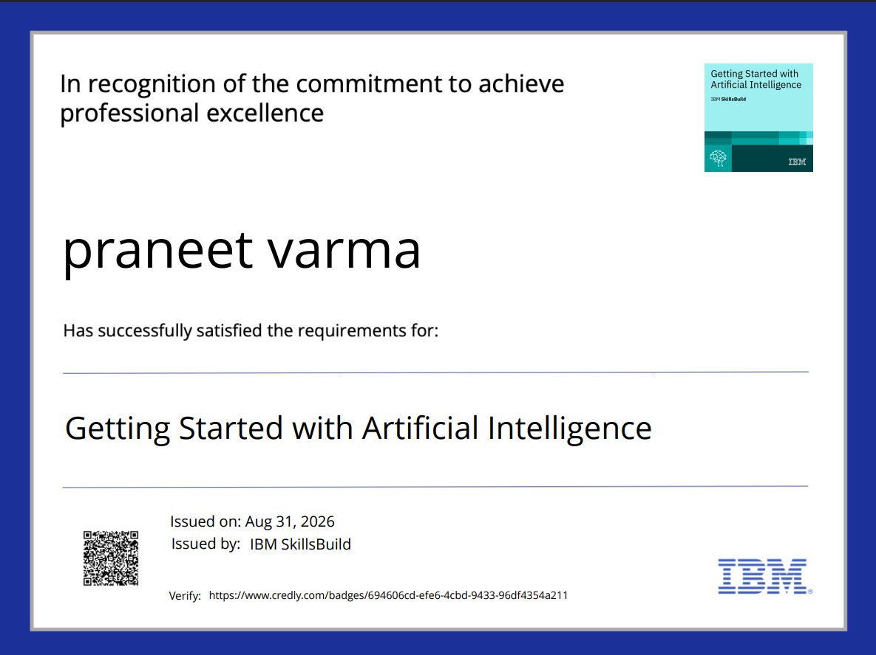
Certificates Earned:
Please add your credly certificate(Getting Started with Artificial Intelligence)

Slide 19
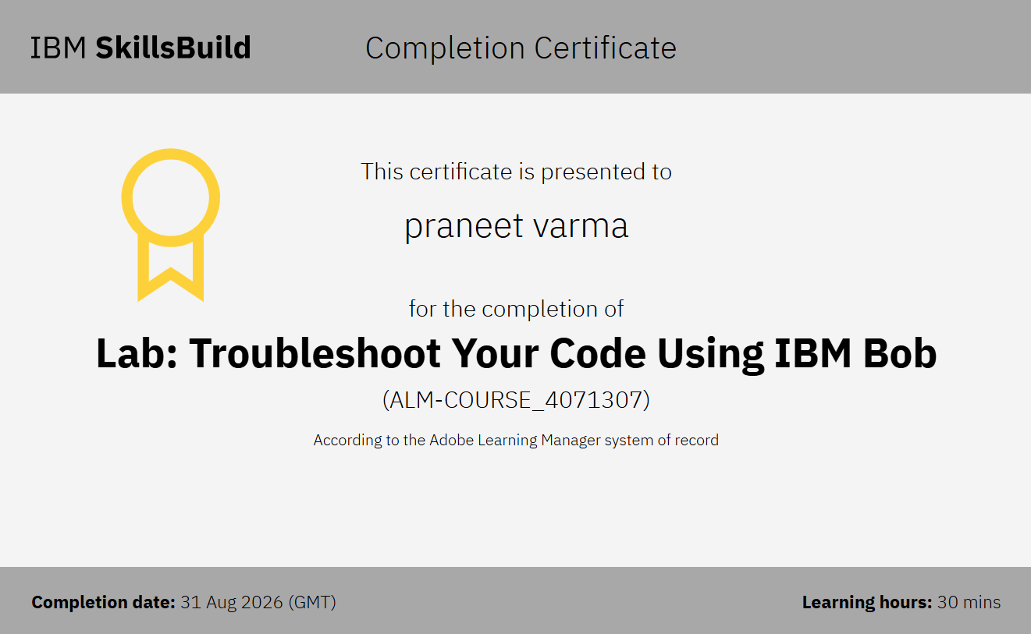
Certificates Earned:​
Add your IBM BOB Certificate

Slide 20


